Slide 1
EE 74099 / EN 74099 Research Project
Project Title: Vision Based Navigation System for Indoor Robots
Progress Presentation – 19
20.09.2019
Under the Supervision of : Dr. WGCW Kumara
And Eng. Abdul Cadar
Team Members:
ANFM. Begum - SEU/IS/13/EG/002
GSU. Ahmadh - SEU/IS/13/EG/011
IIS. Prema Sri - SEU/IS/13/EG/032

Slide 2
Content
Progress This Week
Order Management System – What we have done
Introduction
Home page
Admin page
Food ordering
Database

Slide 3
Progress This Week
As we discussed last week, We worked on OMS and here are the features we included in this.
We covered basic features to cover the purpose of our project.
Here they are,
For Customer,
Food display
Food Order and Table Select
For Administrator
Get order details
Mark order status (Processing, Delivered)
Update Food in Database

Slide 4
Introduction
The Order Management System(OMS) is created to get the orders from the customer and track the progress of each order throughout the system.
We developed the OMS using XAMPP software which contains,
Apache server (HTTP server)
MariaDB (database)
PHP (programming language)
Now, we completed the OMS with new user interface and it can be access on local web server.

Slide 5
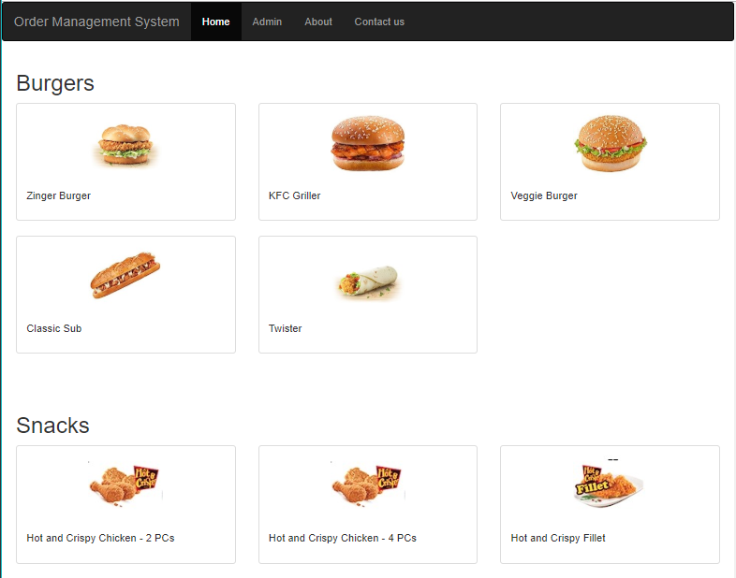
Home page
Home page mainly consists the food menu in which the customer can order their dishes by selecting the image of the dish.
Dishes has been organized into several categories and each one can be ordered separately.
Admin can access the website by login with valid credentials.

Slide 6
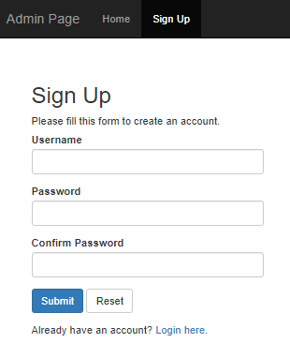
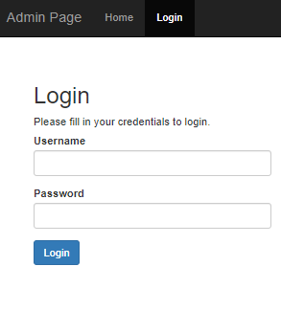
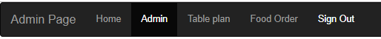
Admin page
To access the database through the webpage, an admin page is created with the requirement of administrator credentials. New login credentials can be created by sign up within the admin page only. Admin can also logout anywhere in the admin page using the sign-out option.

Slide 7
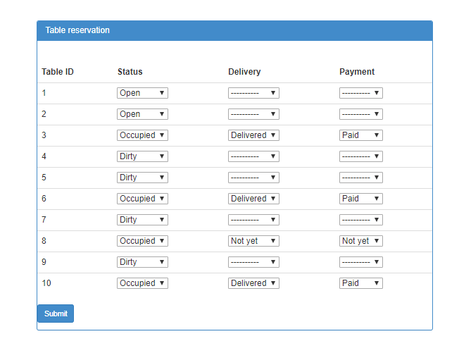
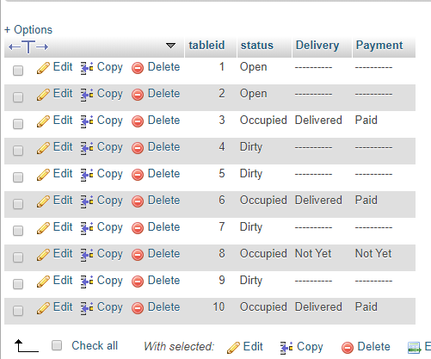
Admin page
To maintain the orders, admin page has some following facilities,
1. Table plan:
Here status of each and every table can be given to the database which can help to display the available table for customers when they are trying to order the food and admin can track the order for the delivery and the payment.

Slide 8
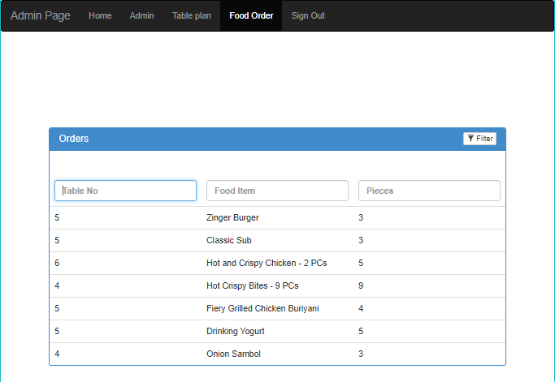
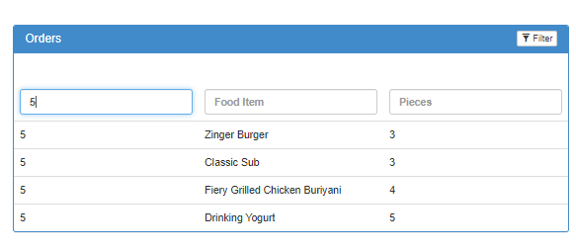
Admin page
2. Order details:
Here orders are displayed to know the dishes and their table number. Filter option is also provided to find out a specific detail.

Slide 9
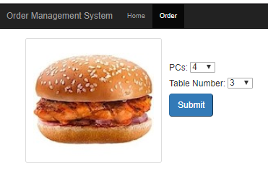
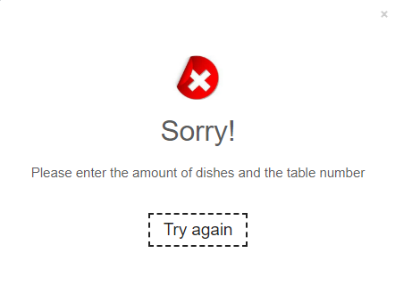
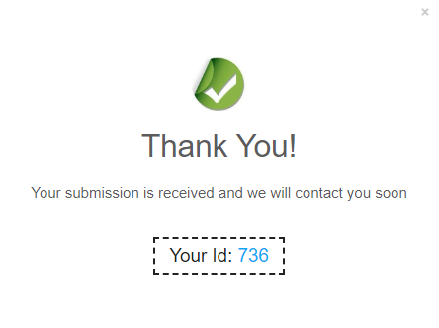
Food Ordering
Customer can submit their order by selecting the amount of food and the table number and also they can receive success popup message. If they fail to submit then the error message can be displayed.

Slide 10
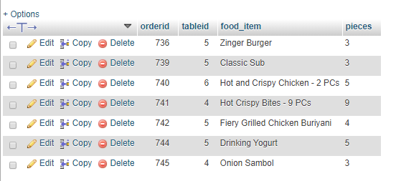
Food Ordering
Finally the ordering details can be updated in the database and admin page.

Slide 11
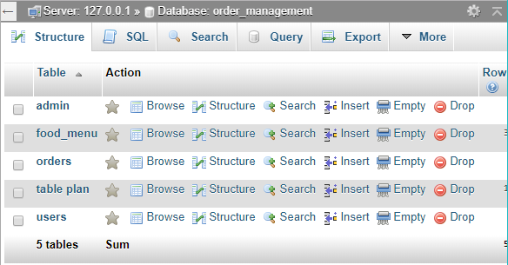
Database
We used the MariaDB database with local server 127.0.0.1
Database has following tables to maintain the OMS.
admin
food_menu
orders
table plan
users

Slide 12
Database
Tables of the database is shown below,
1. admin:
Total number of tables in the restaurant is updated here.
2. food_menu:
Each and every food in the restaurant and their amount, price, and category is inserted here. According to this information, food menu including the image is prepared and displayed for the ordering.
3. orders:
Order with order id, table number, dishes and their amount is updated here. The order id will be the unique value for each customer for their payment and the other clarification. These details will be displayed in the admin page for delivery.

Slide 13
Database
4. table plan:
The availability of the table is updated here through by the admin. It has the status of the table whether it is open or occupied, payment whether it is paid or not and the food delivery whether it is delivered or not.
5. users:
Validate user name and password to access the admin page is updated here.

Slide 14
Thank You

